Slide 1

Project Presentation On
Grocery List Web Application

Slide 2
PRESENTED BY:
KAPIL AGRAWAL
KERKERE MALLIKARJUN
MADHU RAMESH
SARIM RIZVI

Slide 3
OBJECTIVE
The developed application consist registration page where user can register and login.
User will be able to get Grocery details.
User will get the Items List details options.
User will get the payment options.
User will be able to see item in his order list.

Slide 4
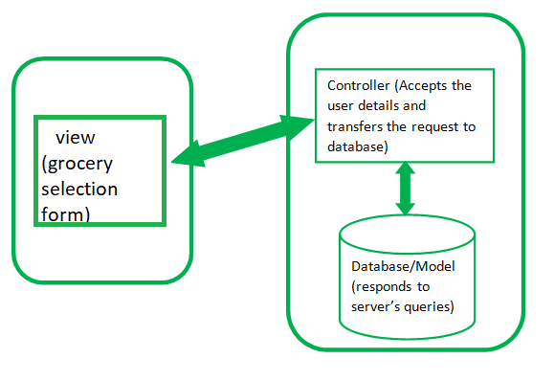
MVC ARCHITECTURE

Slide 5
Tools & Technologies Used:
JDK
Eclipse
MySQL Workbench
Docker
AWS
Spring Boot
Visual Studio Code
Java
Maven Framework
JDBC framework
Spring Framework
MySQL
HTML
CSS
JavaScript
jsp

Slide 6
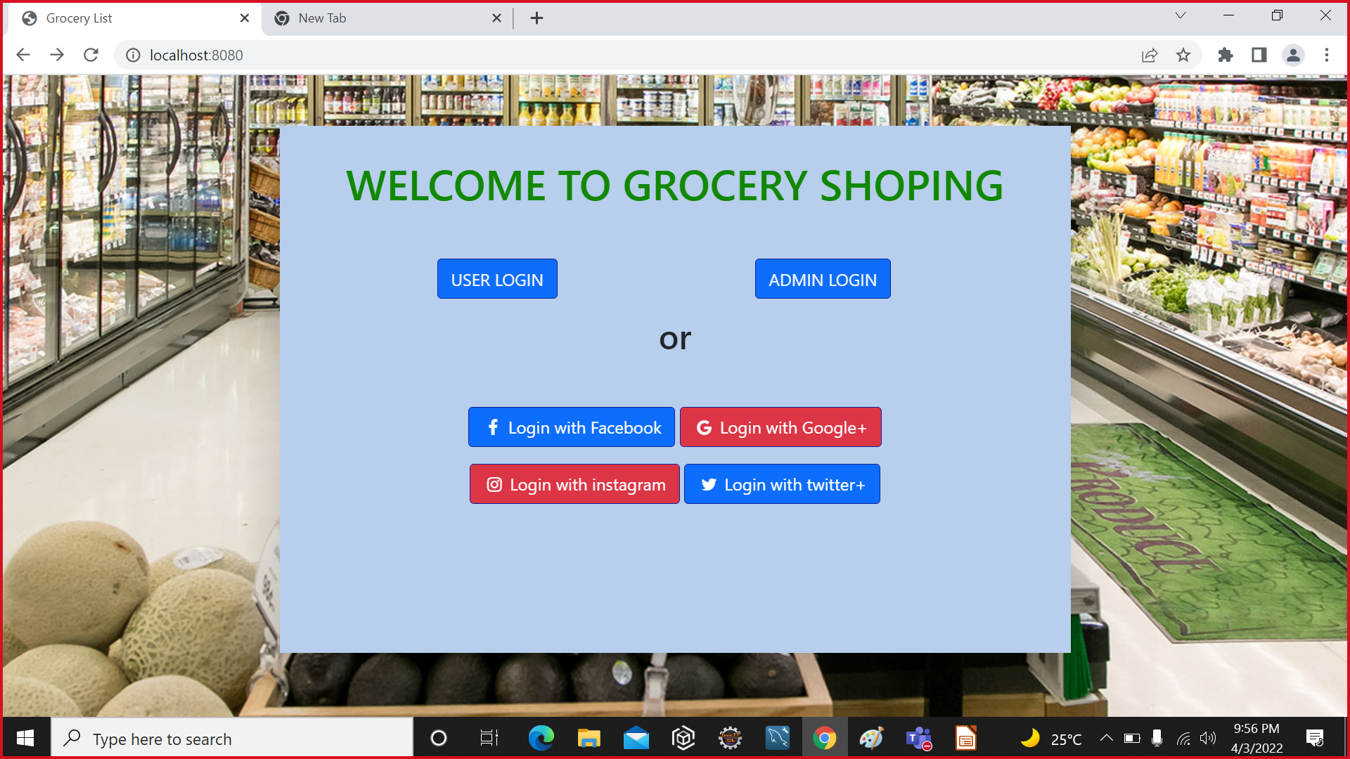

Slide 7
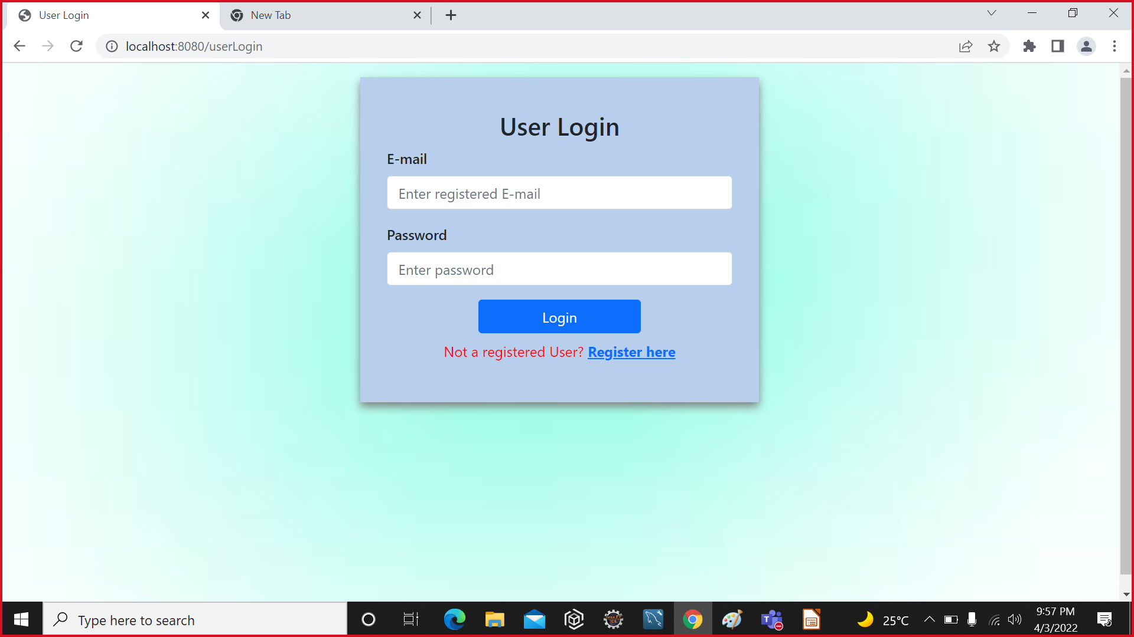

Slide 8
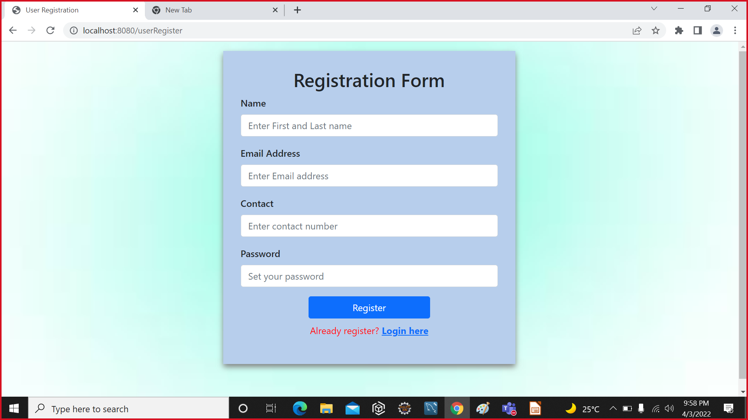

Slide 9
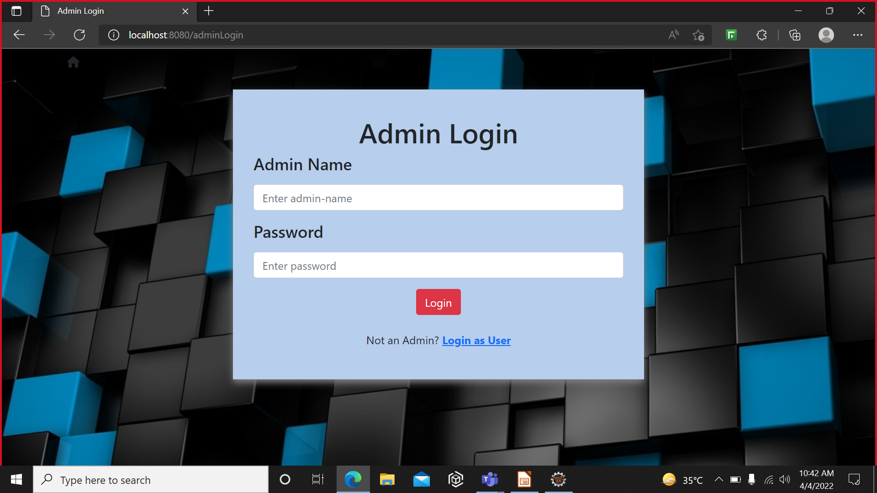

Slide 10
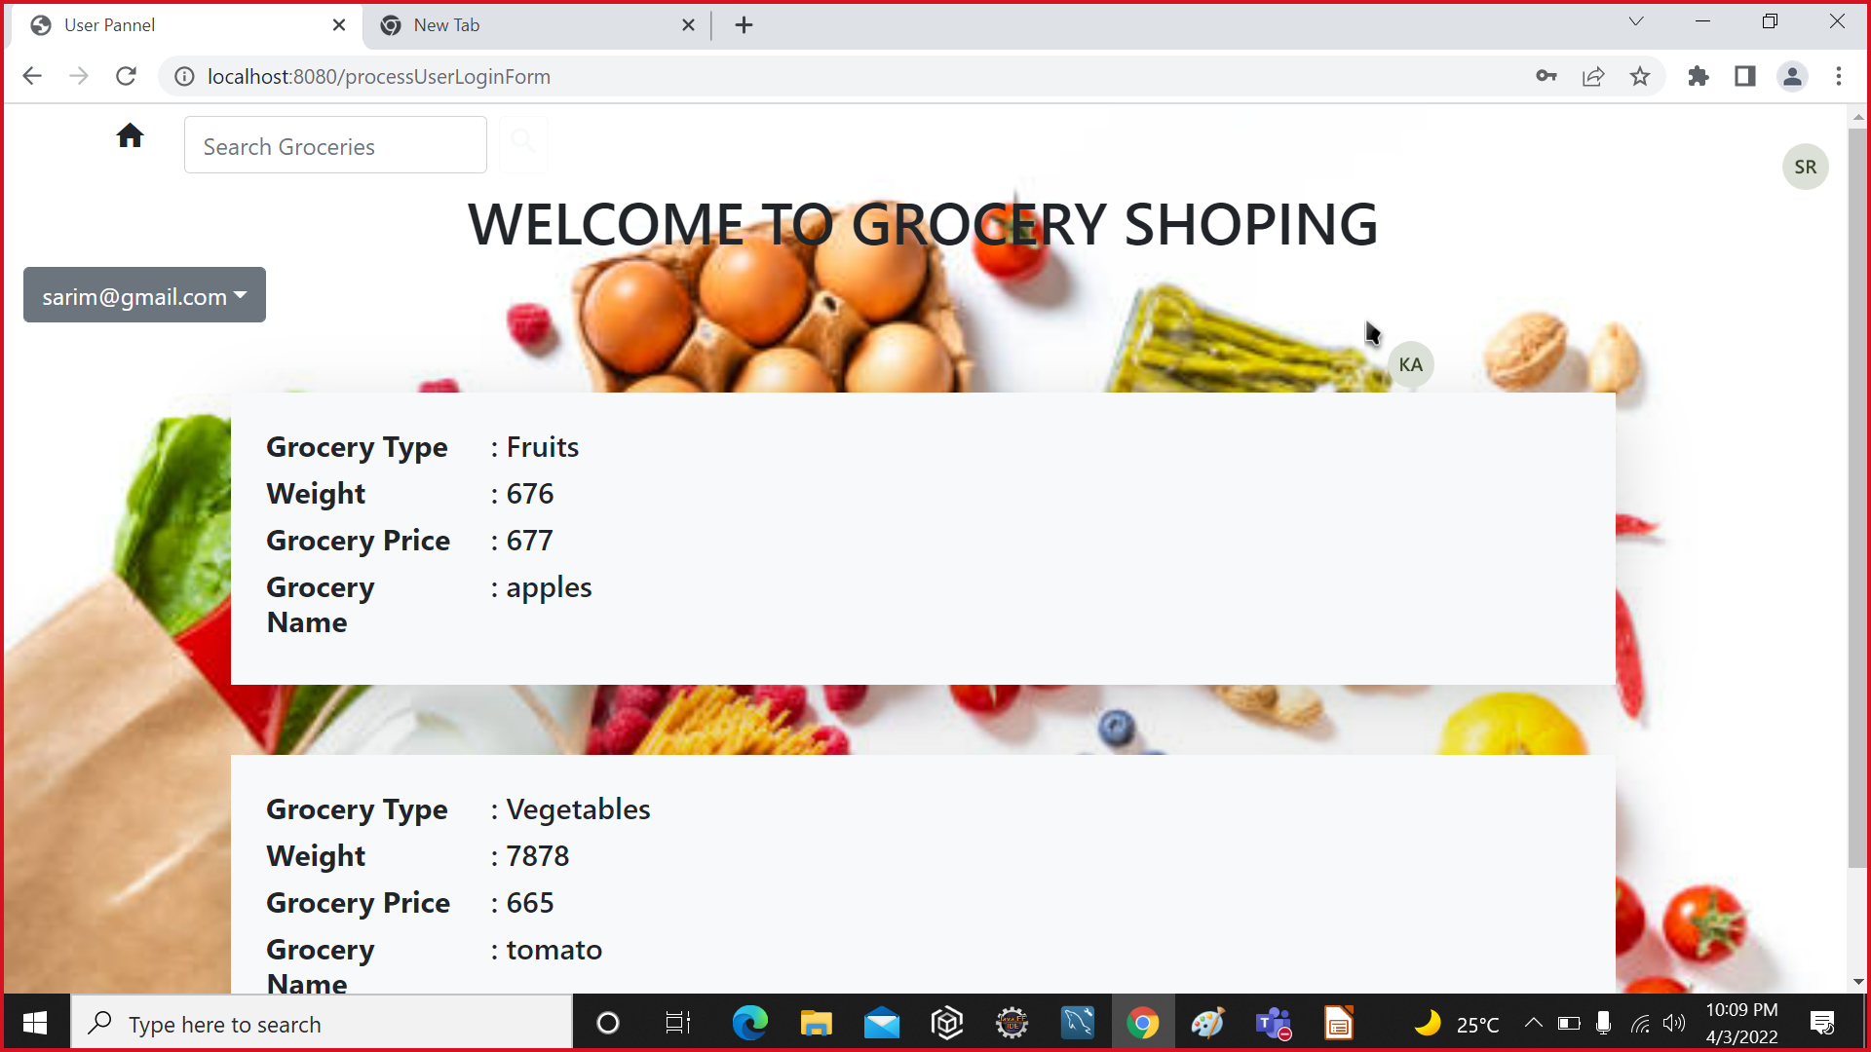

Slide 11
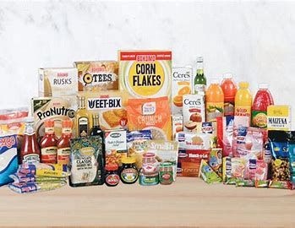
CONCLUSION
The Grocery List Web Application is to used to manage the details of grocery items like fruits, vegetables , snacks etc and also , it manage all the information about grocery items weight, price and type.
The purpose of the project is to build an Application Program to Reduce the manual Work for managing and purchasing the grocery items. As well it will help to avoid the manual errors.

Slide 12
THANK YOU

